Slide 1
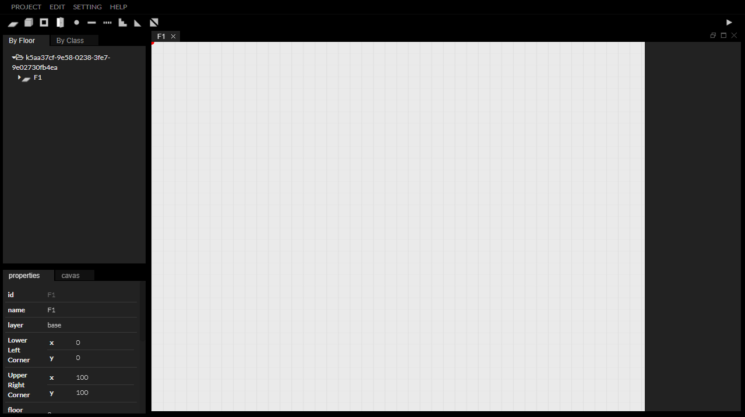


Slide 2

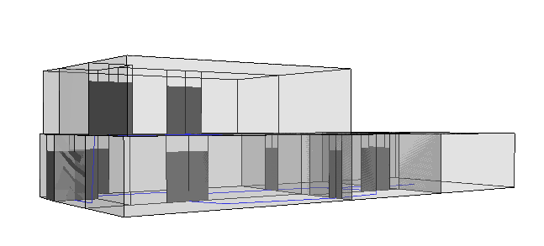
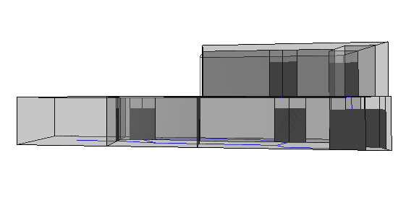
“
How to make an IndoorGML file of
two-story house using InEditor?

Slide 3
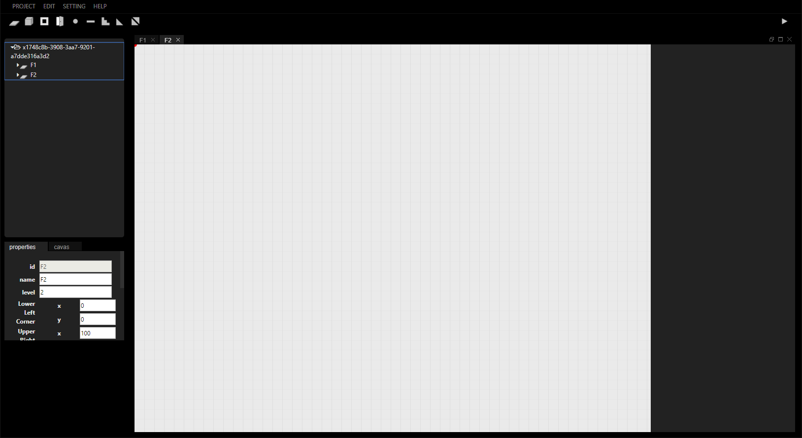
Part 1
Environment
Setting
First of all, you need to set the environment for editing.
In order for you to use InEditor sufficiently, you must install
InFactory that a restful server and library to create OGC IndoorGML and
InViewer that a Three.js-based viewer for visualizing OGC IndoorGML data
as well as InEditor.

Slide 4
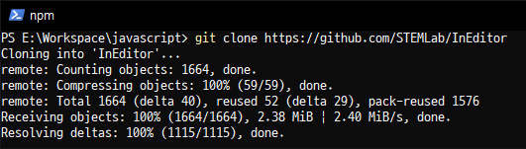
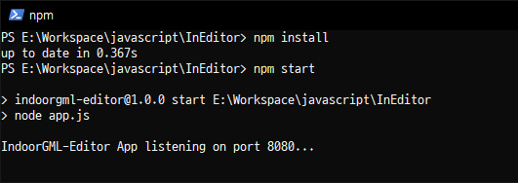
InEditor
Prerequisites
1
- Node.js : InEditor use node for server-side. https://nodejs.org/
Installing
2
- Download project : You can download zip file from https://github.com/STEMLab/InEditor.git
or down using git git clone https://github.com/STEMLab/InEditor.git
- Install module : Open command prompt on project folder
and install module by executing npm install
- Start InEditor : Start server by executing npm start
Launch a web browser and open the editor(http://127.0.0.1:8080).

Slide 5
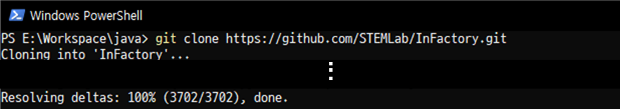
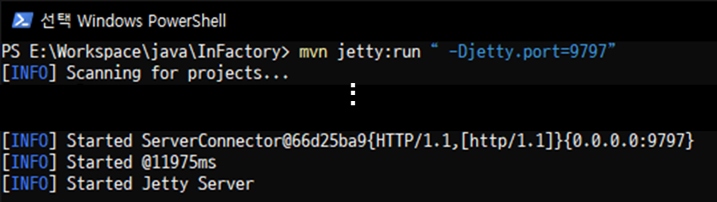
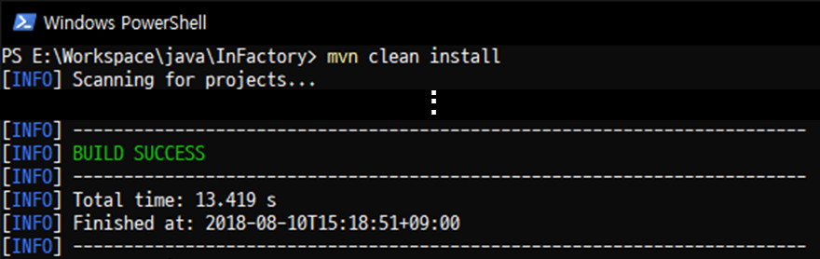
InFactory
Prerequisites
1
- Maven : over 3.5 version.
- Java : JDK over 1.8 version. JAVA 8 is not working at the upper version
Installing
2
- Download project : You can download zip file from https://github.com/STEMLab/InFactory
or down using git git clone https://github.com/STEMLab/InFactory.git
- Build Project : Open command prompt on project folder
and build project by executing mvn clean install
- Start Spring Server : Start server by executing mvn jetty:run “-Djetty.port=9797”

Slide 6
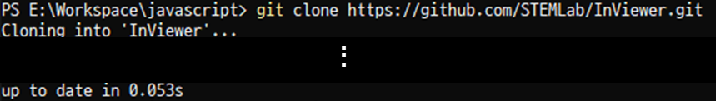
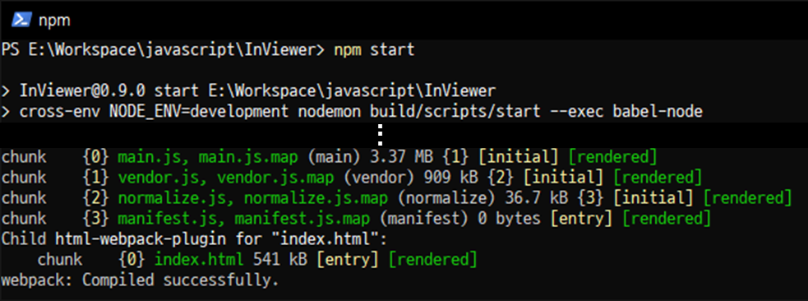
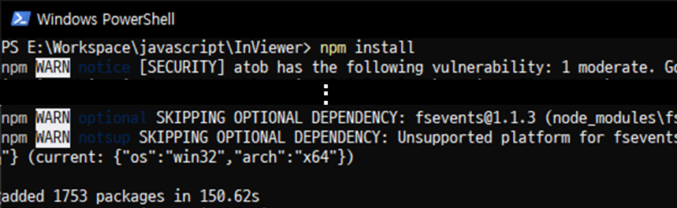
InViewer
Prerequisites
1
- Node.js
Installing
2
- Download project : You can download zip file from https://github.com/STEMLab/InViewer
or down using git git clone https://github.com/STEMLab/InViewer.git
- Install module : Open command prompt on project folder
and install module by executing npm install
- Start InViewer : Start server by executing npm start
Launch a web browser and open the viewer(http://127.0.0.1:3000).

Slide 7
Part 2
Draw two-story
House on
InEditor
Lean basic usage of InEditor
by drawing a simple house.

Slide 8
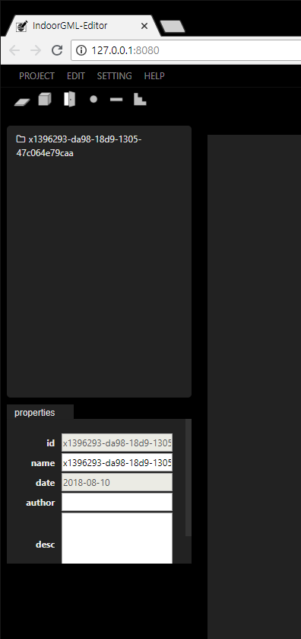
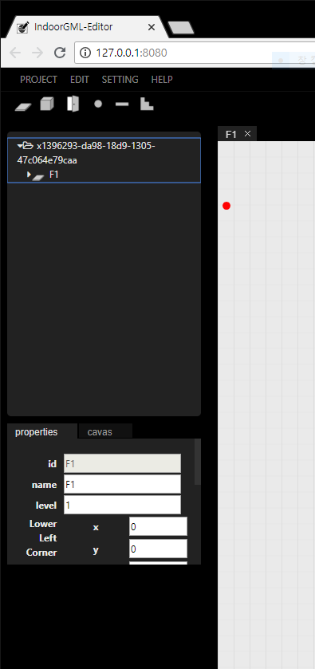
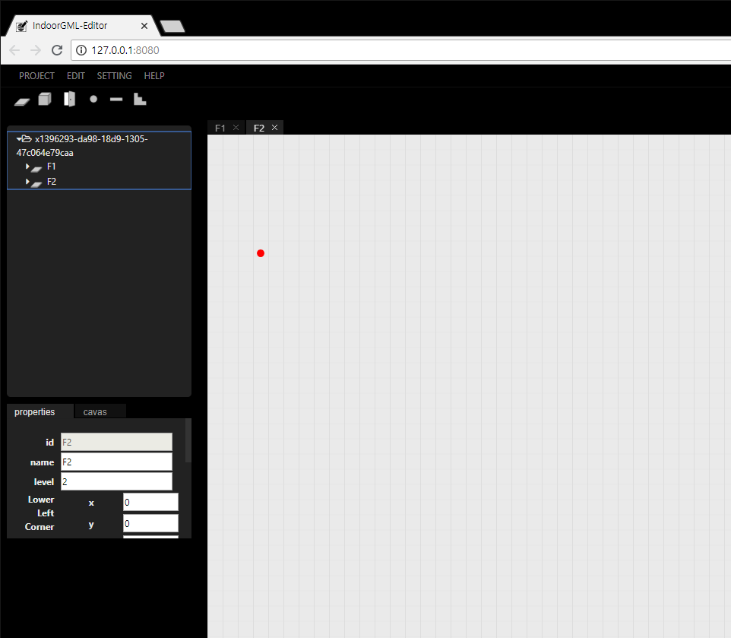
Add two new floor
Click floor button
on tool bar
2. Click button
You can add new floor by clicking floor button on the toolbar

Slide 9
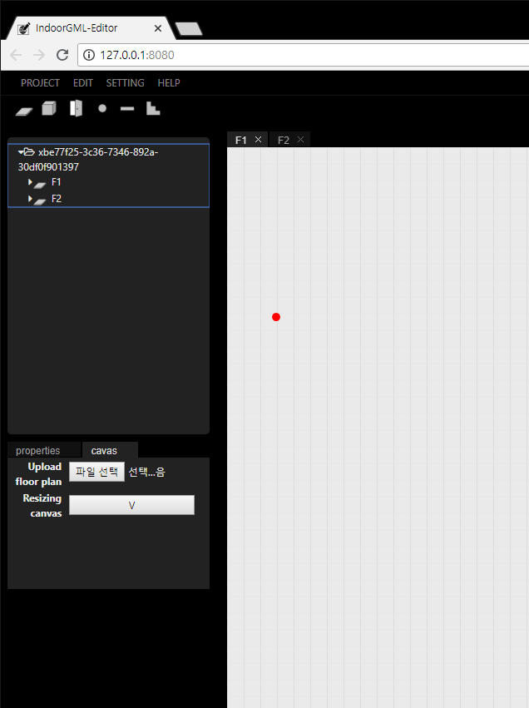
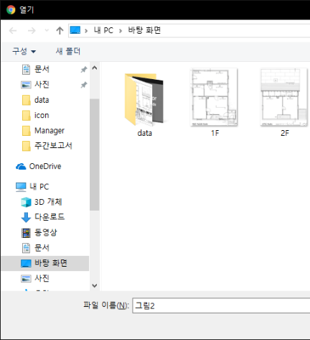
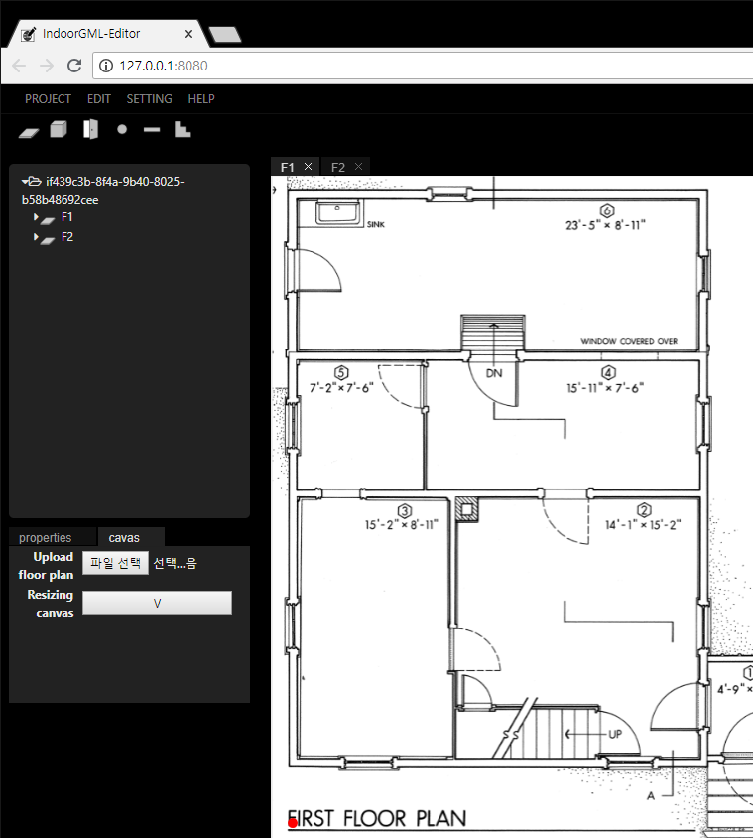
Upload floor plan on the floor
1. Select floor
4. Choose floor plan
2. Select canvas tab
3. Click Upload floor plan button

Slide 10
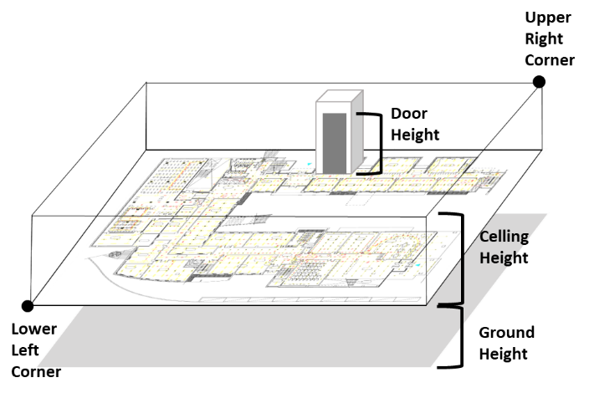
Set floor properties - 1
Floor Properties
name : name of floor
Lower Left Corner / Upper Right Corner : Real coordinates of the bottom left corner and top right corner of the floor.
Ground Height : Height of this floor from the ground.
Ceiling Height : Height of ceiling of this floor.
Door Height : Height of a door of this floor.
Desc : Specific description of this floor.

Slide 11
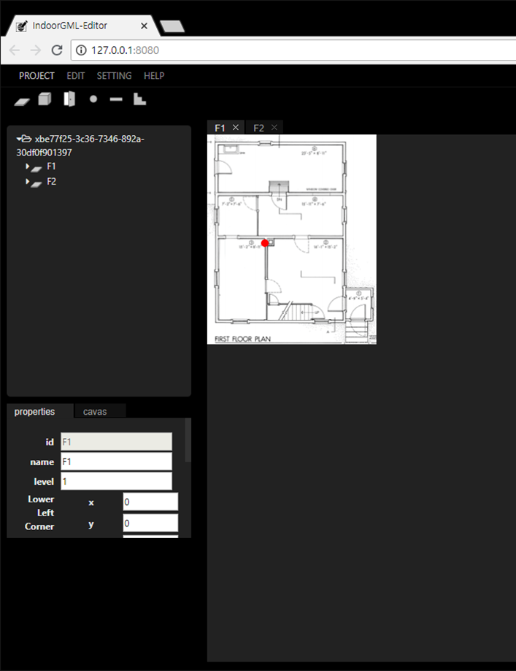
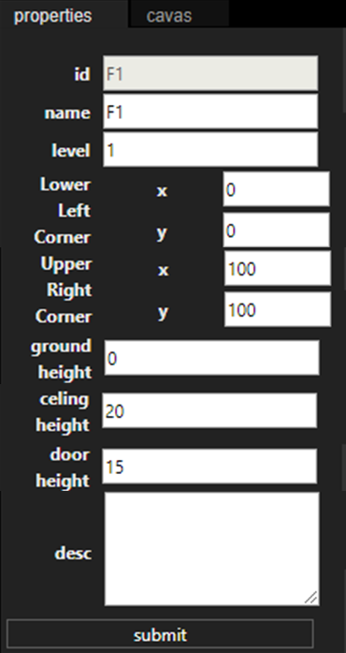

Set floor properties - 2
1. Select floor
120
120
3. Modify value
20
2. Select properties tab
The first floor of house
4. Click submit button

Slide 12
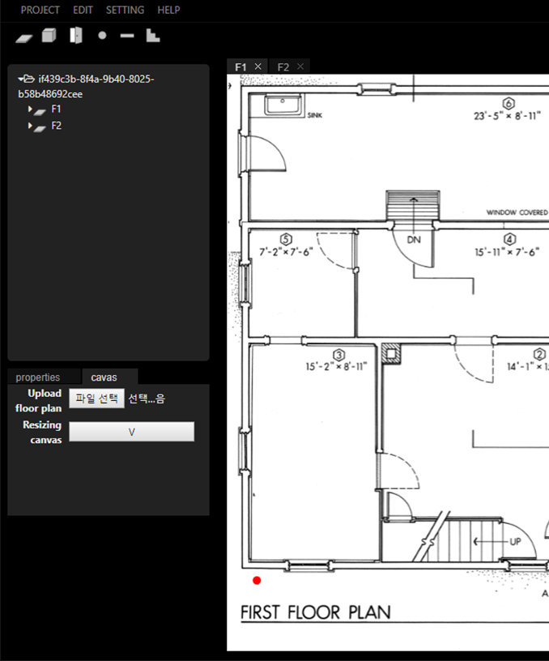
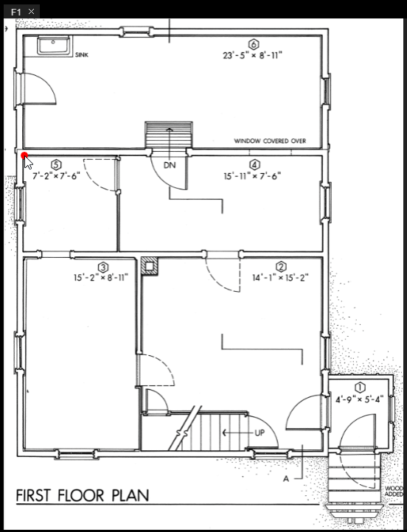
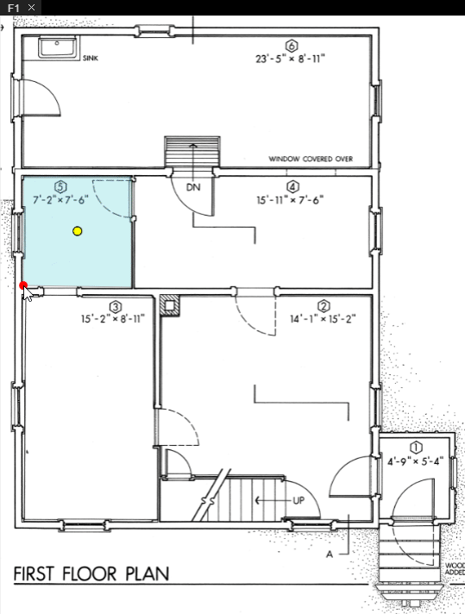
Cell – 1 : create new cell
Click cell button on tool bar or
Press ctrl + c
2. Add corners to cell
by clicking canvas
3. Finish create cell by clicking cell button on tool bar
pressing ctrl+c
pressing enter

Slide 13
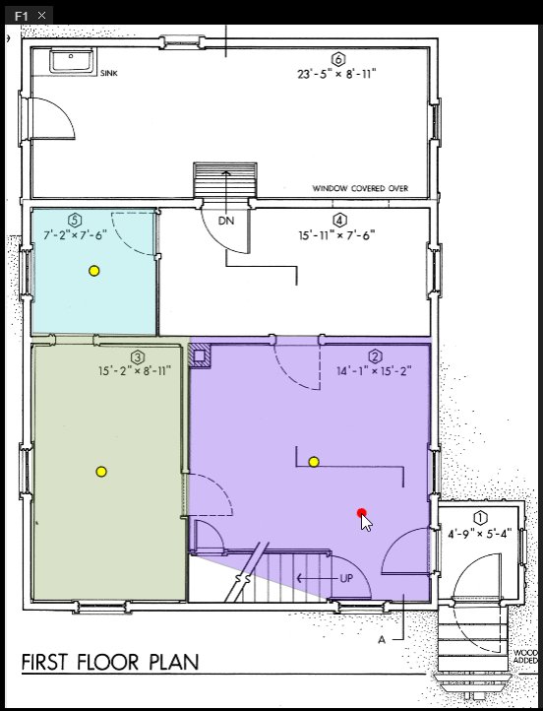
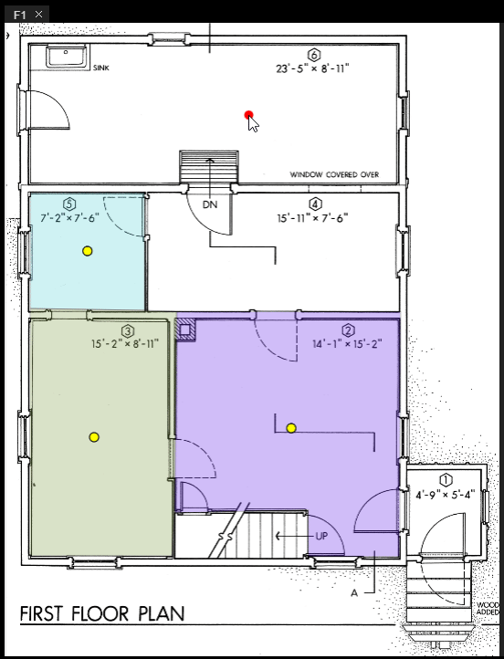
Cell – 2 : modify cell geometry
When you double-click the line you can modify the line
When you press ctrl + z during draw object
the last corner of object will be deleted

Slide 14
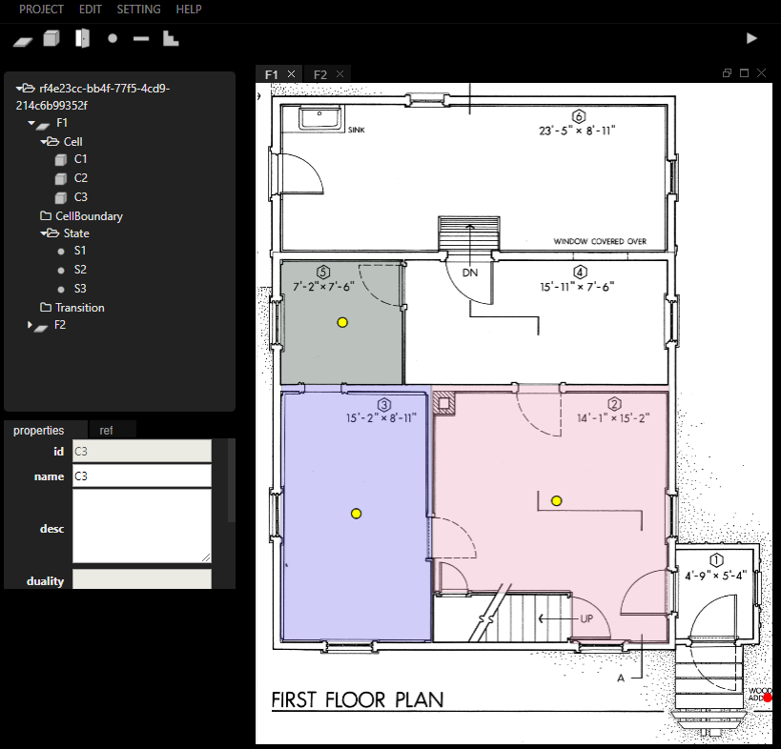
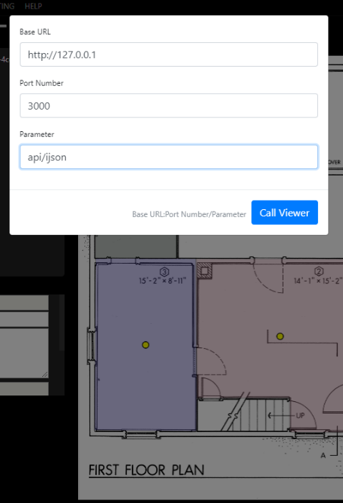
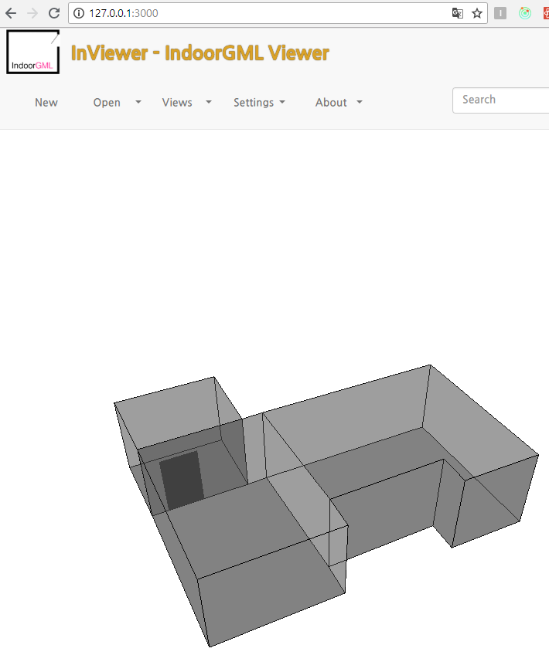
Check the current status in InVeiwer
1. Click viewer button on tool bar
2. Enter the values in modal.

Slide 15
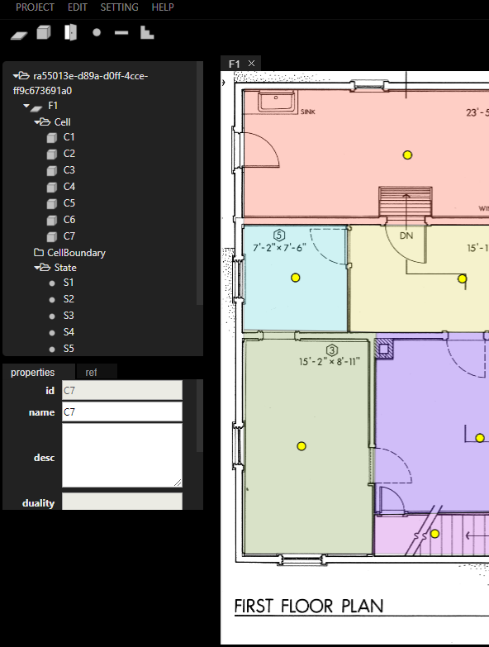
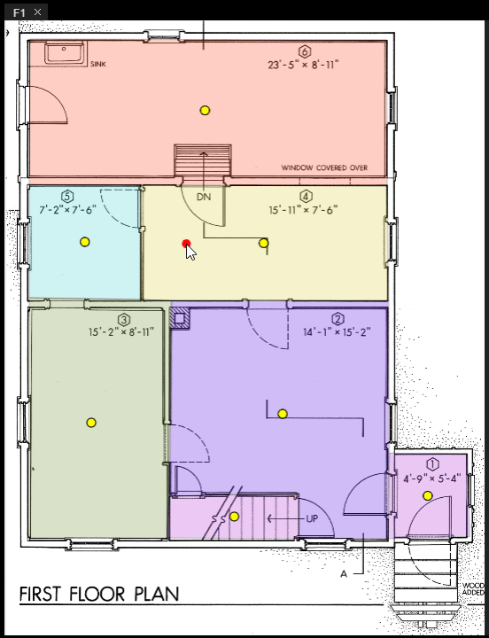
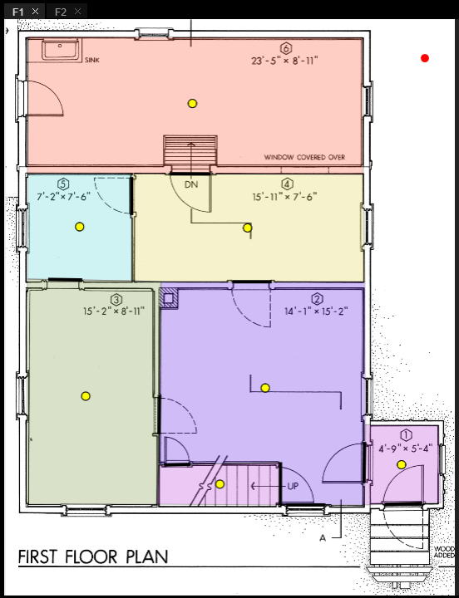
CellSpaceBoundary
Click cellSpaceBoundary button
on tool bar or Press ctrl + b
2. Add corners to cellSpaceBoundary
by clicking canvas
3. Finish create cellSpaceBoundary
by clicking cell button on tool bar
pressing ctrl+c
pressing enter

Slide 16


Transition - 1 : create new transition
Click transition button on tool bar or
Press ctrl + r
2. Select two state to connect
3. If you want to se duality of transition,
click cellSpaceBoundary.
If not, by clicking transition button,
pressing enter or
pressing ctrl+r to finish.

Slide 17
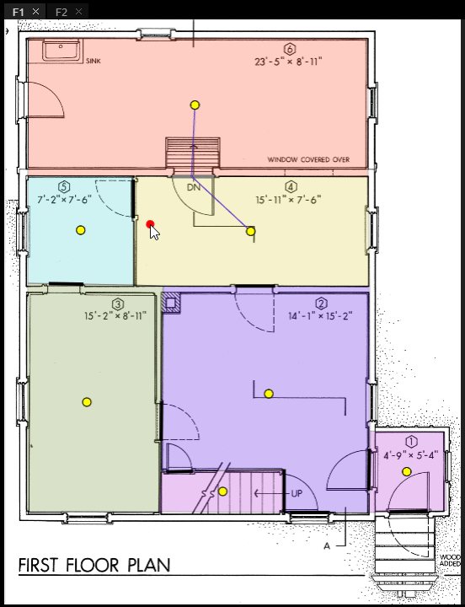
Transition - 2 : modify geometry
When you double-click the line that part of the transition and the dot which represent the state,
you can modify them.

Slide 18
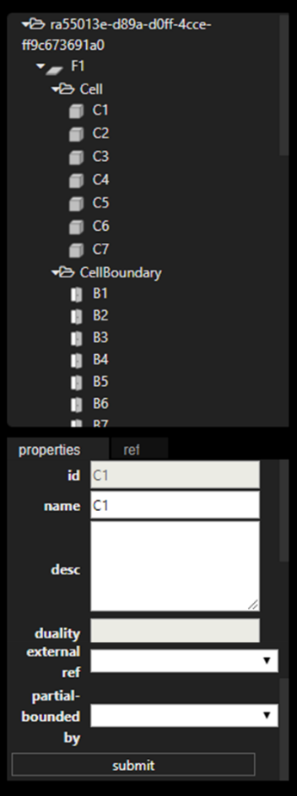

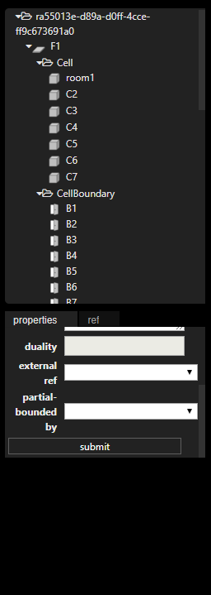
Set properties
Click object on tree view
2. Select properties tab
3. Change value
4. Click submit button

Slide 19
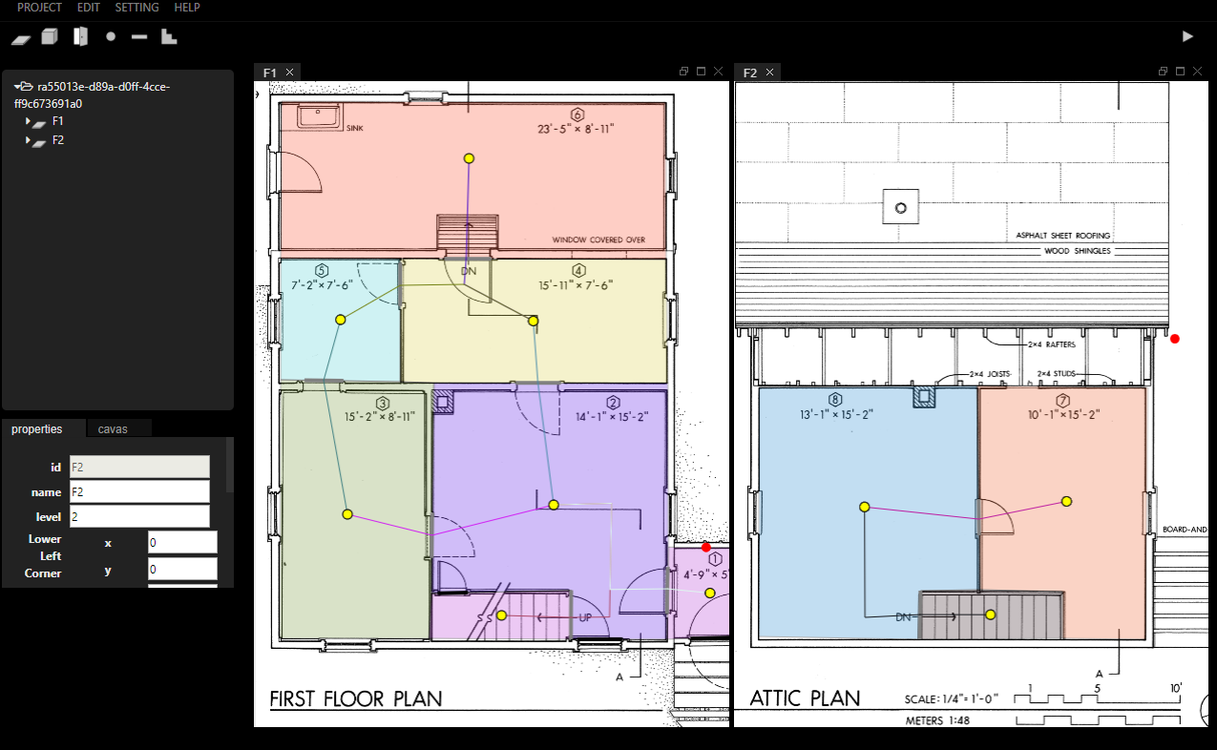
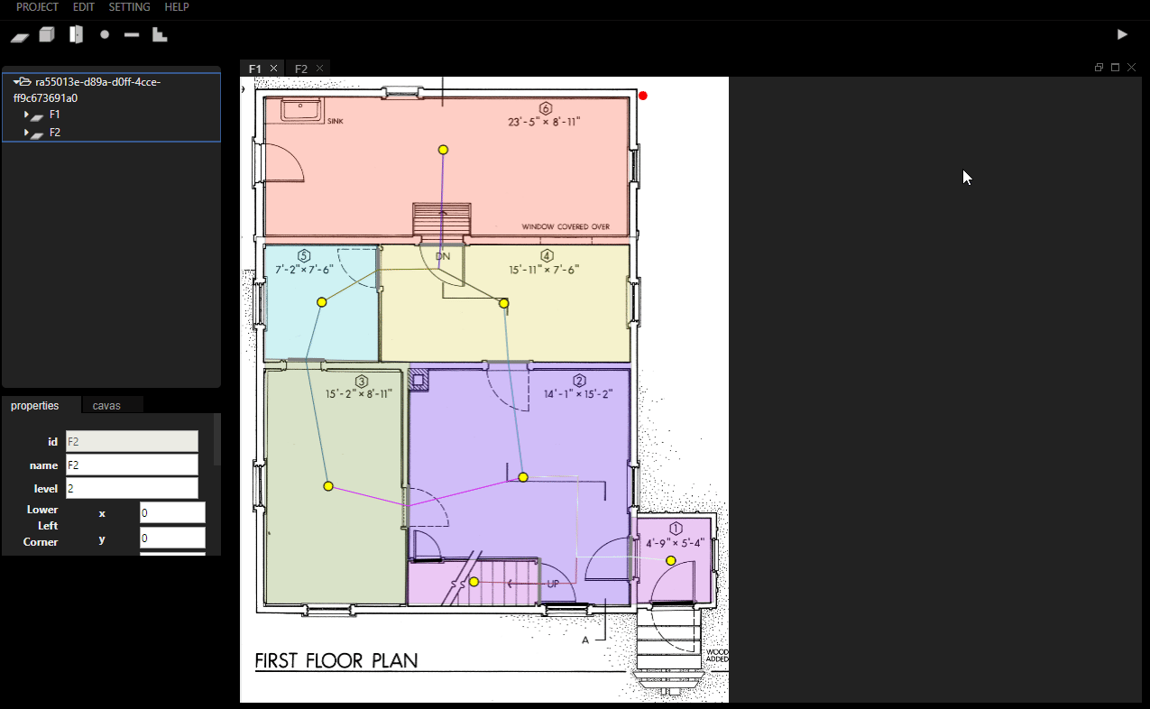
Connect floors - 1
Divide the canvas of two floors.

Slide 20

Connect floors - 2
2. Click stair button on tool bar
3. Choose two states to connect.

Slide 21
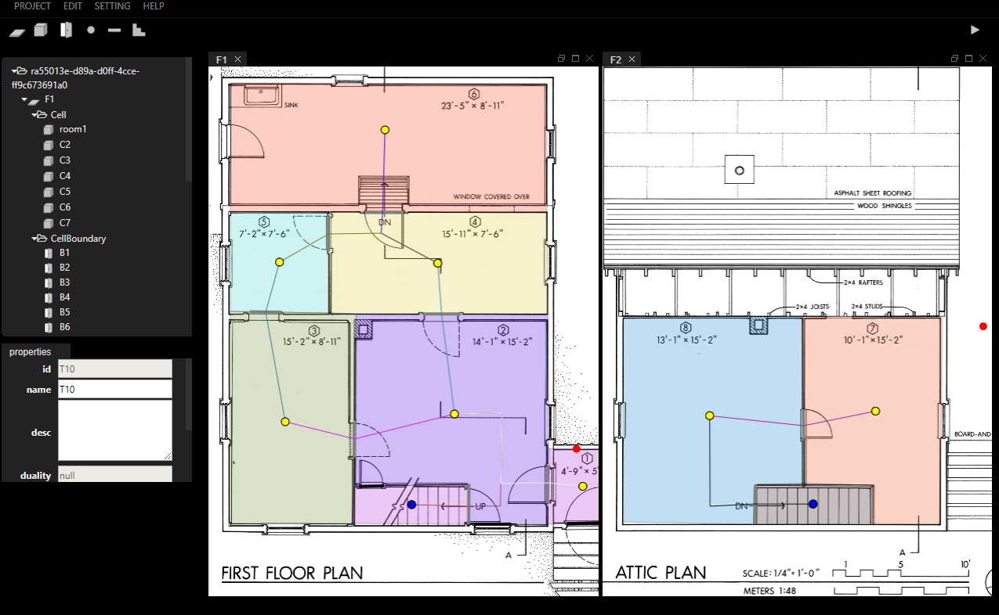
Summary
Add floors.
Upload floor plans.
Set floor properties.
Add Cells, CellSpaceBoundary, State and Transition and set its properties.
Connect floors.

Slide 22
Part 3
Export to
IndoorGML
Get OGC IndoorGML file from InFactory

Slide 23
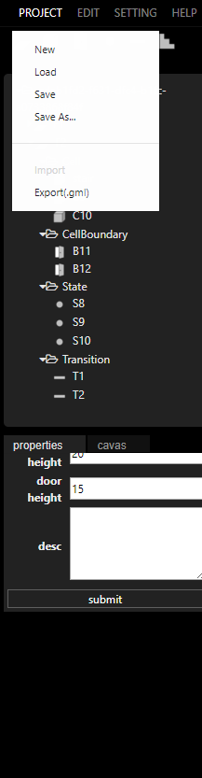
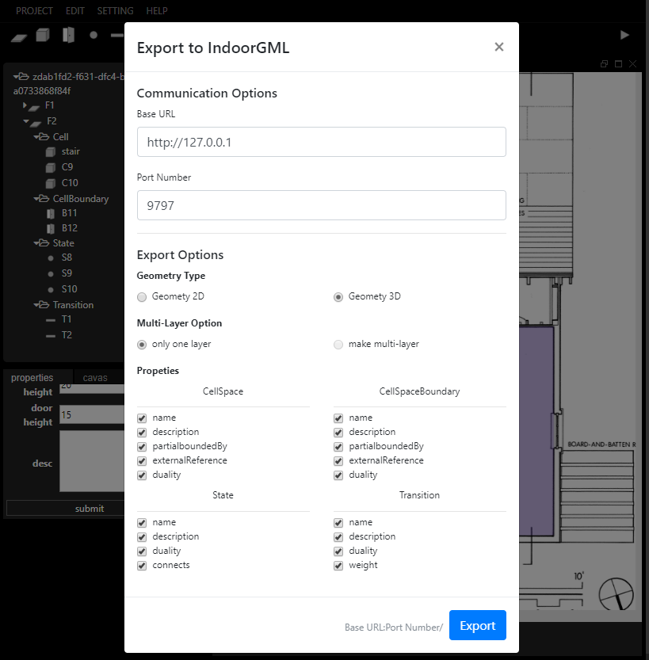
Export to IndoorGML - 1
1. Click Project > Export(.gml)
Export Options
Geometry Option : Determines the dimension of the geometry of the gml file to be created.
If 3D, Cell is Solid and CellSpaceBoundary is Surface.
If 2D, Cell is created as Surface and CellSpaceBoundary is created as LineString.
Properties : According to the schema of IndoorGML, this property may not be displayed in the document because its cardinality is 0..1. If you not select some attributes of them it will not appear in the document.
2. Enter the values in modal.
Select export options.
3. Click Export button

Slide 24
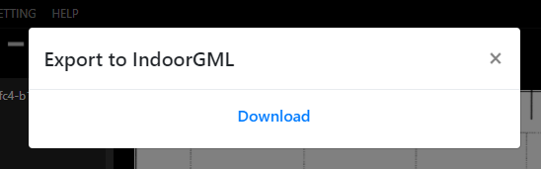
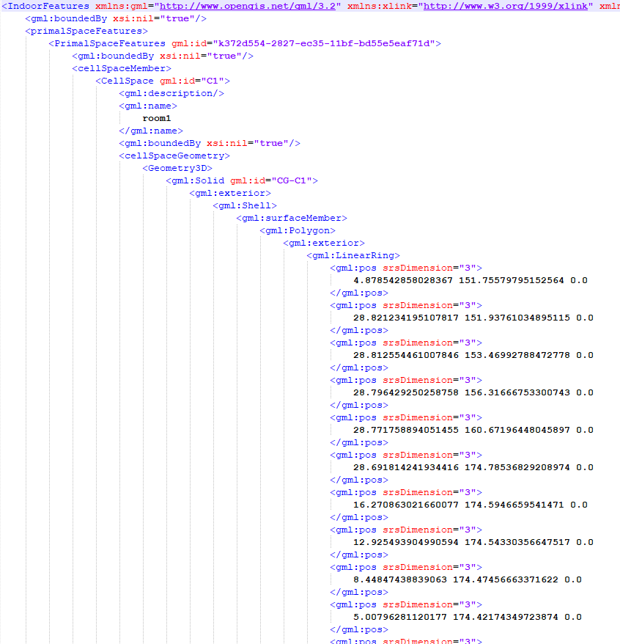
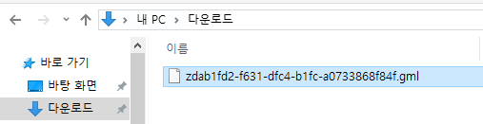
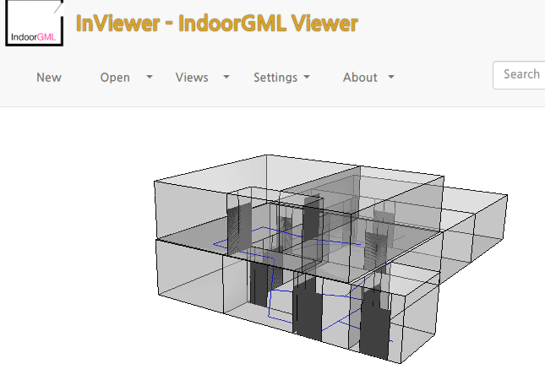
Export to IndoorGML - 2
4. Download gml file

Slide 25
Thank You

